Slide 1
Simplifying and Isolating Failure-Inducing Input
Authors: Andreas Zeller & Ralf Hildebrandt

Slide 2
Introduction
Bugs in large-scale software require simplification for debugging.
Delta Debugging identifies the minimal failure-inducing input.
Example: Mozilla’s BugAThon—370+ open bug reports needed manual simplification.

Slide 3
The Problem Statement
Challenge: Identifying which parts of an input cause failure in large test cases.
Conflicting Goals:
Bug reports must be specific enough for debugging.
Test cases should be minimal for generalization.
Solution: Automate test case simplification with Delta Debugging

Slide 4
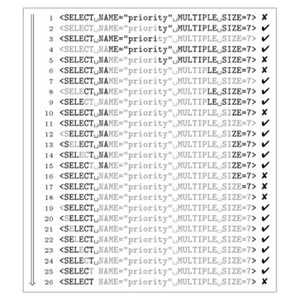
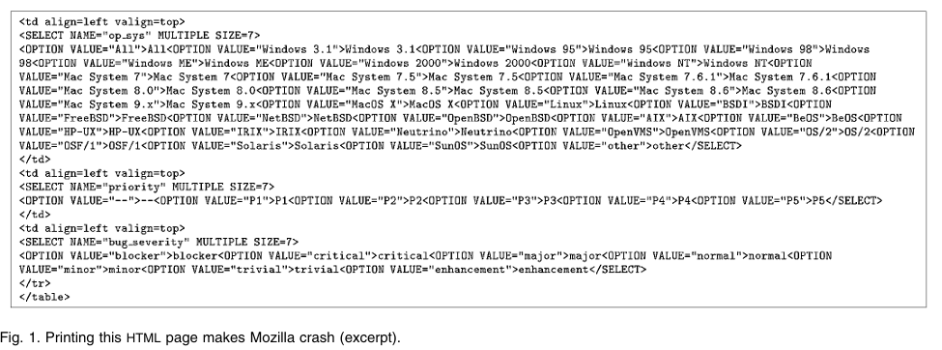
Delta Debugging Approach
Automated process to remove irrelevant input parts iteratively.
Example: Mozilla crash was simplified from 95 user actions to 3 actions.

Slide 5
Delta Debugging Algorithm (ddmin)
Input: Failing test case
Process:
Split input into parts.
Test if each subset still fails.
Reduce to the smallest failing subset.
Output: Minimal failure-inducing input

Slide 6
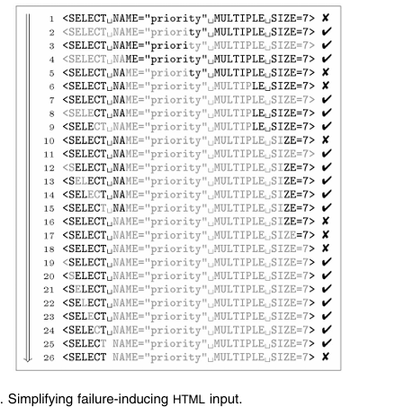
Case Study 1 – Mozilla Print Bug
Bug Report: Printing a webpage crashes Mozilla.
Delta Debugging Steps:
Recorded 95 user actions → reduced to 3 relevant actions.
HTML input reduced from 896 lines to a single line (<SELECT> tag).

Slide 7

Delta Debugging Algorithm (ddmin)
Initial State:
The original webpage had 896 lines of HTML.
A crash occurs, but we don’t know why.
Step 1: Divide Input in Half
We split the 896 lines into:
First half (448 lines): Fails
Second half (448 lines): Does not fail
We keep the failing half.
Step 2: Further Reduction
Keep splitting and testing, reducing down to just one line of HTML.
The crash-inducing element is identified as the <SELECT> tag.
Final Output:
The minimal failure-inducing HTML file consists of just one line that triggers the bug.

Slide 8
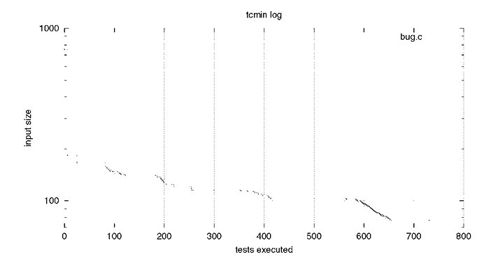
Case Study 2 – GCC Compiler Crash
Case Study 2 – GCC Compiler Crash
Bug Report & Setup:
A C program caused GCC 2.95.2 to crash when compiled with optimization enabled (-O flag)
The crash led to excessive memory usage and forced other processes to terminate.

Slide 9
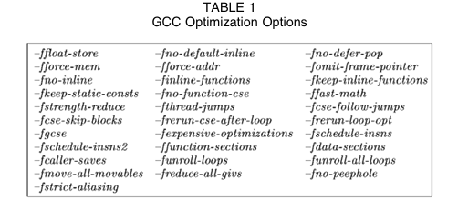
Case Study 2 – GCC Compiler Crash
Delta Debugging Process:
The initial failing input was a 755-character C program.
Using Delta Debugging, the input was minimized to 77 characters.
The critical failure-inducing part was a single assignment in a function.
Further Debugging with GCC Flags:
After minimizing the test case, researchers tried various compiler optimization flags.
Testing with 31 different GCC flags revealed:
-ffast-math prevented the crash but altered program semantics.
-fforce-addr also prevented the crash without affecting semantics.
Finding:
The failure only occurred with optimization enabled.
Removing specific compiler flags could prevent the crash.

Slide 10
Case Study 3 – UNIX Fuzz Testing
Fuzz Testing involves feeding random input to software to uncover hidden bugs.
Miller et al. previously found that 40% of UNIX utilities crashed when given random input.
The goal was to identify minimal failure-inducing inputs for UNIX utilities.
Initial Test Setup:
16 different fuzz inputs were tested across 6 UNIX utilities:
NROFF (text formatting)
TROFF (typesetting)
FLEX (lexical analyzer generator)
CRTPLOT (graphing utility)
UL (underlining filter)
UNITS (unit conversion)

Slide 11
Case Study 3 – UNIX Fuzz Testing
Results of Initial Testing:
43% of utilities crashed when given random input.
Failure cases ranged from buffer overflows to malformed input parsing.
Minimization with Delta Debugging:
Used Delta Debugging (ddmin) to reduce megabytes of input to just a few characters.
Approach:
Divide input in half and test both halves.
Keep failing halves and discard passing ones.
Repeat until reaching minimal input that still causes the failure

Slide 12
Case Study 3 – UNIX Fuzz Testing
Initial Test Setup:
16 different fuzz inputs were tested across 6 UNIX utilities:
NROFF (text formatting)
TROFF (typesetting)
FLEX (lexical analyzer generator)
CRTPLOT (graphing utility)
UL (underlining filter)
UNITS (unit conversion)
Results of Initial Testing:
43% of utilities crashed when given random input.
Failure cases ranged from buffer overflows to malformed input parsing.

Slide 13
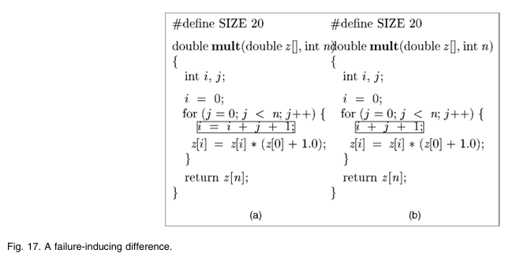
Isolating Failure-Inducing Differences
Test Cases: A subset of input changes affecting program execution.
Delta Debugging (ddmin): Minimizes failing test cases by iteratively removing parts of input.
Delta Debugging (dd): Isolates failure-inducing differences by comparing failing & passing cases.

Slide 14
Comparing ddmin vs. dd
Algorithm | Purpose | Efficiency | Use Case
ddmin | Simplifies a failing test case | Slower | Large test cases
dd | Isolates differences between passing & failing cases | Faster | Finding root cause
Feature | ddmin (Minimization) | dd (Isolation)
Complexity (Best Case) | O(n) | O(log⁡n)
Complexity (Worst Case) | O(n^2) | O(n^2)

Slide 15
Precision in Debugging: Ensuring Correct Failure Detection
- Issue: Reducing input might trigger a different failure than the original.
- Solution: Use backtrace comparison (stack traces) to ensure the same failure occurs.
- Example: Comparing call stack locations to confirm whether it's the same bug or a different one.

Slide 16
When Should You Use dd or ddmin?
Use dd for large inputs → Faster failure isolation
Use ddmin when no passing test case is available
Use backtrace comparison for better debugging
dd is preferred if a minimal difference can be isolated quickly
In Mozilla case, ddmin took 26 tests to simplify the HTML input. dd isolated the failure-inducing difference in just 7 tests. dd was significantly more efficient in pinpointing the <SELECT> tag
For GCC Bug, ddmin required 731 tests to minimize the test case. dd isolated the failure-inducing difference in just 59 tests. dd pinpointed the issue to two characters in an assignment.
For UNIX Fuzz Testing ddmin required over 10,000 tests for some fuzz inputs.dd reduced failure-inducing input in just 24 tests in some cases. dd helped quickly isolate the minimal failure-inducing character.

Slide 17
Limitations
High Test Execution Cost: Requires multiple test executions, making it slow for large test cases.
Handling Non-Deterministic Failures: Struggles with bugs that don’t always occur in the same way.
Lack of Contextual Understanding: It only reduces input size but doesn’t explain why the failure occurs.
Size of Input Matters: Works best for structured inputs like HTML but struggles with unstructured data.
Complexity for Large Inputs: More test runs are required for very large files, leading to performance issues.

Slide 18
Summary & Impact
Delta Debugging automates debugging by simplifying test cases.
Saves developers time and effort in bug tracking.
Has applications in compiler debugging, web browsers, and fuzz testing.

Slide 19
THANKS
Presentation by
Shuvanidhi Suresh- 40293590

